Slide 1
CS-205/503 Data Structure and Algorithms
9. Array Lists and Node Lists
Weihao Qu
Monmouth University

Slide 2
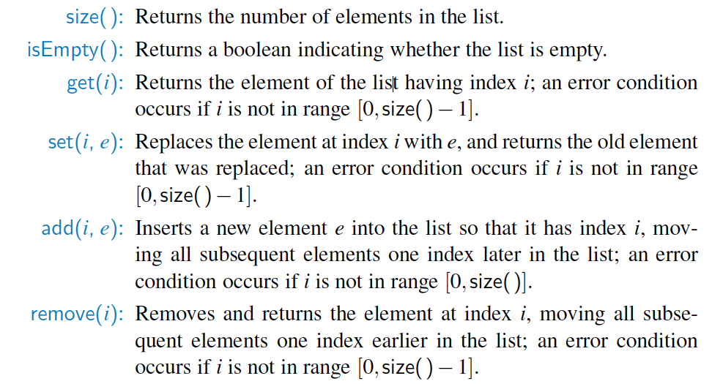
The java.util.List ADT
The java.util.List interface includes the following methods:

Slide 3
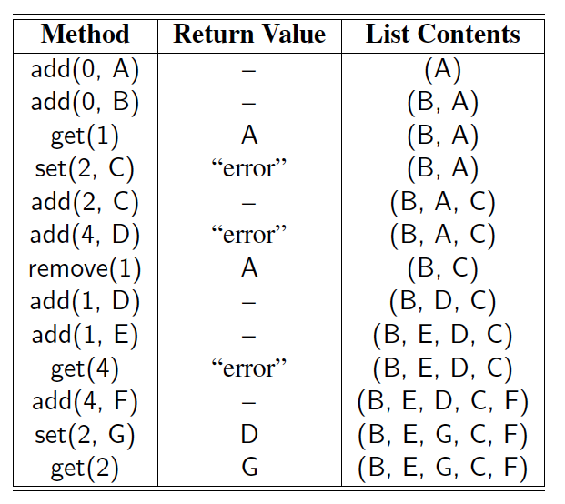
Example
A sequence of List operations:

Slide 4
Array lists
A collection S of n elements in a certain linear order is a list, or sequence
  can refer to the elements as first, second, third and so on.
The index of an element e in S is the number of elements preceding e in S
First element in S has index 0, the last element has index n-1.
A sequence that supports access to its elements by their indices is called an array list or vector (old term).

Slide 5
ADT of array lists
size()
isEmpty()
get(i)
  Return the element of S with index i
set(i, e)
  Replace with e and return the element at index i, an error condition occurs if i<0 or i>size()-1
add(i, e)
  Insert a new element e into S to have index i; an error condition occurs if i<0 or i>size()
remove(i)
  Remove and return from S the element at index i; an error condition occurs if i<0 or i>size()-1.

Slide 6
Example
Operations Output S
add(0, 7) - (7)
add(0, 4) - (4, 7)
get(1) 7 (4, 7)
add(2, 2) - (4, 7, 2)
get(3) “error” (4, 7, 2)
remove(1) 7 (4, 2)
add(1, 5) - (4, 5, 2)
add(1, 3) - (4, 3, 5, 2)
set(3, 8) 2 (4, 3, 5, 8)

Slide 7
Array Lists
An obvious choice for implementing the list ADT is to use an array, A, where A[i] stores (a reference to) the element with index i.
With a representation based on an array A, the get(i) and set(i, e) methods are easy to implement by accessing A[i] (assuming i is a legitimate index).
A
0
1
2
i
n

Slide 8
Insertion
In an operation add(i, o), we need to make room for the new element by shifting forward the n − i elements A[i], …, A[n − 1]
In the worst case (i = 0), this takes O(n) time
A
0
1
2
i
n
A
0
1
2
i
n
A
o
0
1
2
i
n

Slide 9
Element Removal
In an operation remove(i), we need to fill the hole left by the removed element by shifting backward the n − i − 1 elements A[i + 1], …, A[n − 1]
In the worst case (i = 0), this takes O(n) time
A
o
0
1
2
i
n
A
0
1
2
i
n
A
0
1
2
i
n

Slide 10
Performance
In an array-based implementation of a dynamic list:
  The space used by the data structure is O(n)
  Indexing the element at i takes O(1) time
  add and remove run in O(n) time
In an add operation, when the array is full, instead of throwing an exception, we can replace the array with a larger one …

Slide 11
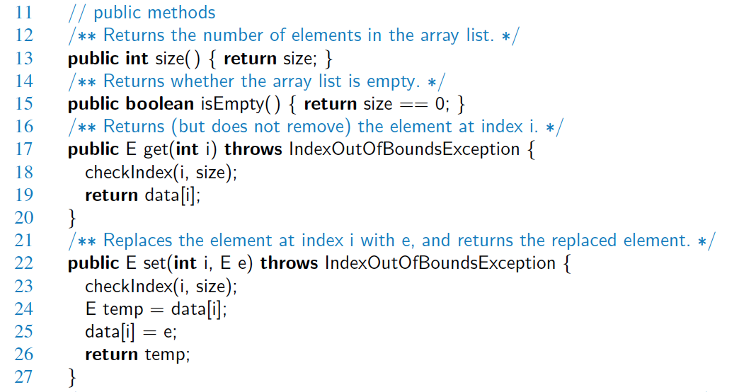
Java Implementation

Slide 12
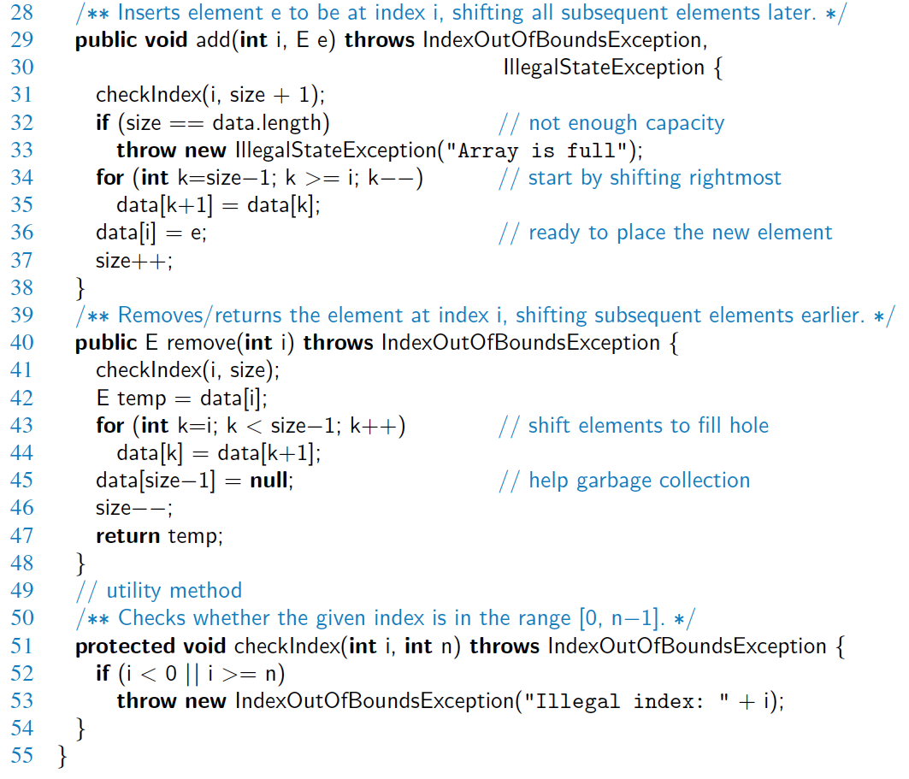
Java Implementation, 2

Slide 13
Growable Array-based Array List
Let push(o) be the operation that adds element o at the end of the list
When the array is full, we replace the array with a larger one
How large should the new array be?
  Incremental strategy: increase the size by a constant c
  Doubling strategy: double the size
Algorithm push(o)
if t = S.length − 1 then
A ← new array of
size …
for i ← 0 to n−1 do
A[i] ← S[i]
S ← A
n ← n + 1
S[n−1] ← o

Slide 14
Comparison of the Strategies
We compare the incremental strategy and the doubling strategy by analyzing the total time T(n) needed to perform a series of n push operations
We assume that we start with an empty list represented by a growable array of size 1
We call amortized time of a push operation the average time taken by a push operation over the series of operations, i.e., T(n)/n

Slide 15
Incremental Strategy Analysis
Over n push operations, we replace the array k = n/c times, where c is a constant
The total time T(n) of a series of n push operations is proportional to
n + c + 2c + 3c + 4c + … + kc =
n + c(1 + 2 + 3 + … + k) =
n + ck(k + 1)/2
Since c is a constant, T(n) is O(n + k²), i.e., O(n²)
Thus, the amortized time of a push operation is O(n)

Slide 16
Doubling Strategy Analysis
We replace the array k = log₂ n times
The total time T(n) of a series of n push operations is proportional to
n + 1 + 2 + 4 + 8 + …+ 2^{k} =
n + 2^{k + 1} − 1 =
3n − 1
T(n) is O(n)
The amortized time of a push operation is O(1)
geometric series
2
4
1
1
8

Slide 17
Implementing an array list using extendable arrays
Java.util.ArrayList overcomes a weakness in the simple array implementation
Arrays require specification of a fixed capacity N when created
If actual number of elements n is much smaller than N, memory wasted
If n increases past N, program crash
Extendable array technique: when n = N,
  Allocate a new array B of capacity 2N
  Let B[i] ← A[i], for I = 0, 1, … N-1
  Let A ← B, that is, we use B as the array supporting S
  Insert the new element in A

Slide 18
Implementing an array list using extendable arrays
public class ArrayIndexList<E>
implements indexList<E> {
private E[] A;
int capacity = 16;
int size = 0;
public ArrayIndexList() {
A = (E[]) new Object[capacity];
}
public void add(int r, E e)
throws IndexOutOfBoundsException {
checkIndex(r, size() + 1);
if (size == capacity) {
capacity=2*capacity;
E[] B =(E[]) new Object[capacity];
for (int i=0; i<size; i++)
B[i] = A[i];
A = B;
}
for (int i=size-1; i>=r; i--)
A[i+1] = A[i];
A[r] = e;
size++;
}

Slide 19
Implementing an array list using extendable arrays
/** Removes the element stored at the given index. */
public E remove(int r) throws IndexOutOfBoundsException {
checkIndex(r, size());
E temp = A[r];
for (int i=r; i<size-1; i++) // shift elements down
A[i] = A[i+1];
size--;
return temp;
}

Slide 20
Amortized analysis of extendable arrays
Replacing an array required by some element insertion can take O(n) time.
However, after an array replacement, the new array allows us to add n new elements before next replacement
Proposition:
  Let S be an array list implemented by means of an extendable array with initial length one.
  The total time to perform a series of n push operations in S, starting from S being empty is O(n).

Slide 21
Traverse Arraylist
ArrayList<String> a = new ArrayList<String>();
for (int i = 0; i < a.size(); i++) { //1. loop with index
System.out.println(a.get(i));
}
for (String s : a) { //2. foreach loop
System.out.println(s);
}
//3. Iterator
for (Iterator<String> iter = a.iterator(); iter.hasNext(); ) {
System.out.println(iter.next());
}

Slide 22
Iterator and Iterable
Java ArrayList implements iterator and iterable
Program exercise
Page 300-301
R-7.2, 7.5, 7.10

Slide 23
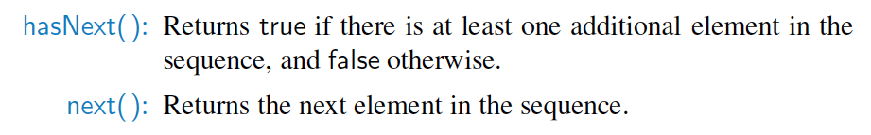
Iterators
An iterator is a software design pattern that abstracts the process of scanning through a sequence of elements, one element at a time.

Slide 24
The Iterable Interface
Java defines a parameterized interface, named Iterable, that includes the following single method:
  iterator( ): Returns an iterator of the elements in the collection.
An instance of a typical collection class in Java, such as an ArrayList, is iterable (but not itself an iterator); it produces an iterator for its collection as the return value of the iterator( ) method.
Each call to iterator( ) returns a new iterator instance, thereby allowing multiple (even simultaneous) traversals of a collection.

Slide 25
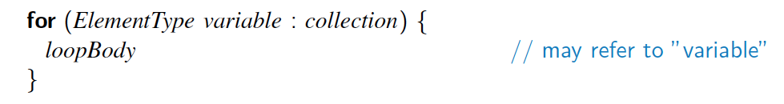
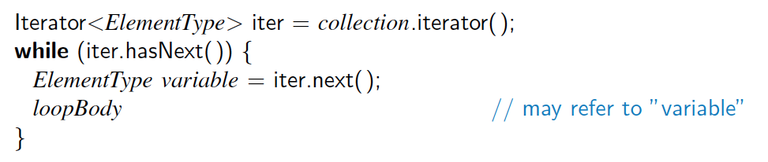
The for-each Loop
Java’s Iterable class also plays a fundamental role in support of the “for-each” loop syntax:
  is equivalent to:

Slide 26
Node lists
Using an index is not the only means of referring to the place where an element appears in a sequence
If a sequence S is implemented with a linked list, then it is more nature to use a node as a means of identifying where to access and update S
A node is used as a “position”
A position is always defined relatively, e.g.
  A position p is “after” some position q and before some position s

Slide 27
Node list ADT
first(): return the position of the first element of S
last()
prev(p): return the position of the element of S preceding the one at position p; an error occurs if p is the first position
next(p)
set(p, e): replace the element at position p with e, returning the element formerly at position p
addFirst(e)
addLast(e)
addBefore(p, e)
addAfter(p, e)
remove(p)

Slide 28
Example
Operation Output S
addFrist(8) - (8)
First() p₁(8) (8)
addAfter(p₁, 5) - (8,5)
next(p₁) p₂(5) (8,5)
addBefore(p₂, 3) - (8,3,5)
prev(p₂) p₁(5) (8,3,5)
addFrist(9) - (9,8,3,5)
last() p₄(5) (9,8,3,5)
remove(frist()) 9 (8,3,5)
set(p₂,7) 3 (8,7,5)
addAfter(first(),2) - (8,2,7,5)

Slide 29
Interface Position
public interface Position<E> {
/** Return the element stored at this position. */
E element();
}
Position is an ADT

Slide 30
Interface PositionList
public interface PositionList<E> {
public int size();
public boolean isEmpty();
public Position<E> first();
public Position<E> last();
public Position<E> next(Position<E> p)
throws InvalidPositionException, BoundaryViolationException;
public Position<E> prev(Position<E> p)
throws InvalidPositionException, BoundaryViolationException;
public void addFirst(E e);
public void addLast(E e);
public void addAfter(Position<E> p, E e) throws InvalidPositionException;
public void addBefore(Position<E> p, E e) throws InvalidPositionException;
public E remove(Position<E> p) throws InvalidPositionException;
public E set(Position<E> p, E e) throws InvalidPositionException;
}

Slide 31
Class DNode implements Position
public class DNode<E> implements Position<E> {
private DNode<E> prev, next;
public DNode(DNode<E> newPrev, DNode<E> newNext, E elem) {
prev = newPrev; next = newNext; element = elem;
}
public E element() throws InvalidPositionException {
if ((prev == null) && (next == null))
throw new InvalidPositionException("Position is not in a list!");
return element;
}
public DNode<E> getNext() { return next; }
public DNode<E> getPrev() { return prev; }
public void setNext(DNode<E> newNext) { next = newNext; }
public void setPrev(DNode<E> newPrev) { prev = newPrev; }
public void setElement(E newElement) { element = newElement; }
}

Slide 32
Class NodePositionList implements PositionList
public class NodePositionList<E> implements PositionList<E> {
protected int numElts;
DNode<E> header, trailer;
public NodePositionList() {
numElts = 0;
header = new DNode<E>(null, null, null);
trailer = new DNode<E>(header, null, null); header.setNext(trailer);
}

Slide 33
Class NodePositionList
protected DNode<E> checkPosition(Position<E> p) throws InvalidPositionException {
if (p == null) throw new InvalidPositionException ("Null position passed to NodeList");
if (p == header)
throw new InvalidPositionException ("The header node is not a valid position");
if (p == trailer)
throw new InvalidPositionException ("The trailer node is not a valid position");
try {
DNode<E> temp = (DNode<E>) p;
if ((temp.getPrev() == null) || (temp.getNext() == null))
throw new InvalidPositionException ("Position is invalid.");
return temp;
}
catch (ClassCastException e) {
throw new InvalidPositionException ("Position is of wrong type for this list");
}
}

